Slide 1

Delta Rule/ Widrow-Hoff rule / Gradient Descent Rule

Slide 2
Adaline Model
ADALINE (Adaptive Linear Neuron or later Adaptive Linear Element) is a single layer neural network based on McCulloh Pitts Model difference is that in a learning phase i.e. it has weight adjustment .
Input / output relation is linear
It was developed by Professor Bernard Widrow and his graduate student Ted Hoff at Stanford University in 1960.
Learn by delta rule or Least Mean Square rule or Widrow-Hoff rule

Slide 3
Madaline Model
Madaline (Multiple Adaline) is a two layer neural network with a set of ADALINEs in parallel as its input layer and a single PE (processing element) in its output layer.
MADALINE (many Adaline) network is created by combining a number of Adalines. The network of ADALINES can span many layers
For problems with multiple input variables and one output, each input is applied to one Adaline. For similar problems with multiple outputs, madalines in parallel can be used.
The madaline network is useful for problems which involve prediction based on multiple inputs, such as weather forecasting (Input variables: barometric pressure, difference in pressure. Output variables: rain, cloudy, sunny).

Slide 4
b
y
b
b
b
Input layer
Madaline layer
b
Adaline Layer
Structure of Madaline

Slide 5
Why Delta Rule ?
Although the Perceptron rule finds a successful weight vector when the training examples are linearly separable, it can fail to converge if the examples are not linearly separable.
This training rule, called the delta rule, is designed to overcome this difficulty.

Slide 6
Gradient Descent Rule in Multiple Dimensions
Gradient Descent Rule:
w _{new} = w _{old} - η Δ ( w)
where
Δ (w) is the gradient and
η is the learning rate (small, positive)
Notes:
1. This moves us downhill in direction Δ (w) (steepest downhill direction)
2. How far we go is determined by the value of η
3. The Perceptron learning rule is a special case of this general method

Slide 7
Illustration of Gradient Descent
E(w)
w₁
w₀

Slide 8
Illustration of Gradient Descent
E(w)
w₁
w₀

Slide 9
Illustration of Gradient Descent
E(w)
w₁
Direction of steepest
descent = direction of
negative gradient
w₀

Slide 10
Illustration of Gradient Descent
E(w)
w₁
Original point in
weight space
New point in
weight space
w₀

Slide 11
Comments on the Gradient Descent Algorithm
Equivalent to hill-climbing
Local minima
  can have multiple local minima (note: for perceptron, E(w) only has a single global minimum, so this is not a problem)
  gradient descent goes to the closest local minimum:
    solution: random restarts from multiple places in weight space
  (note: no local minima for perceptron learning)

Slide 12


Gradient Descent and Delta Rule
The delta training rule is best understood by considering the task of training an unthresholded Perceptron; that is, a linear unit for which the output o is given by
In order to derive a weight learning rule for linear units, let us begin by specifying a measure for the training error of a hypothesis (weight vector), relative to the training examples.

Slide 13
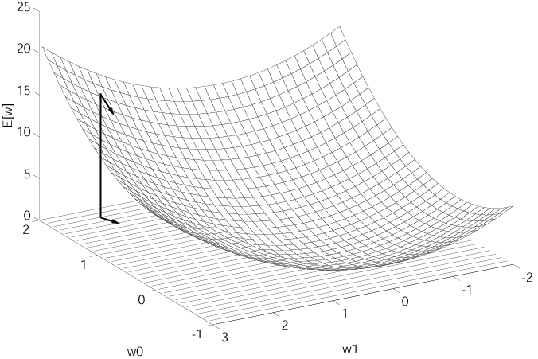
Visualizing the Hypothesis Space
initial weight vector by random
minimum error

Slide 14





Derivation of the Gradient Descent Rule
The vector derivative is called the gradient of E with respect to , written
The gradient specifies the direction that produces the steepest increase in E. The negative of this vector therefore gives the direction of steepest decrease. The training rule for gradient descent is

Slide 15



Derivation of the Gradient Descent Rule (cont.)
The negative sign is presented because we want to move the weight vector in the direction that decreases E. This training rule can also written in its component form
which makes it clear that steepest descent is achieved by altering each component of in proportion to .

Slide 16
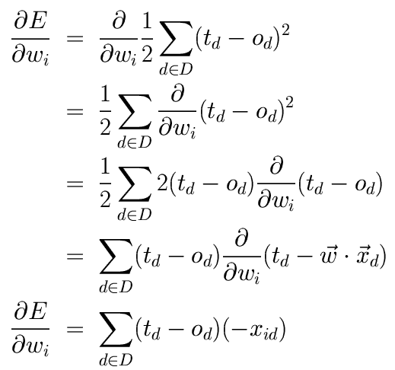

Derivation of the Gradient Descent Rule (cont.)
The vector of derivatives that form the gradient can be obtained by differentiating E
The weight update rule for standard gradient descent can be summarized as

Slide 17
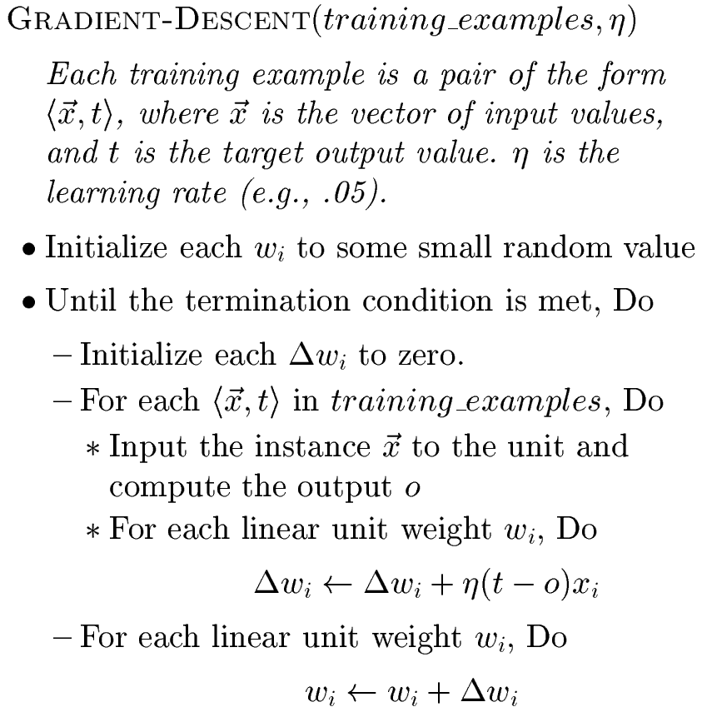
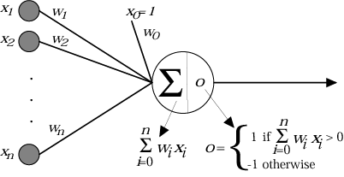

Stochastic Approximation to Gradient Descent

Slide 18
Summary of Perceptron
Perceptron training rule guaranteed to succeed if
training examples are linearly separable
sufficiently small learning rate
2. Linear unit training rule uses gradient descent
guaranteed to converge to hypothesis with minimum squared error
given sufficiently small learning rate
even when training data contains noise

